Slide 1
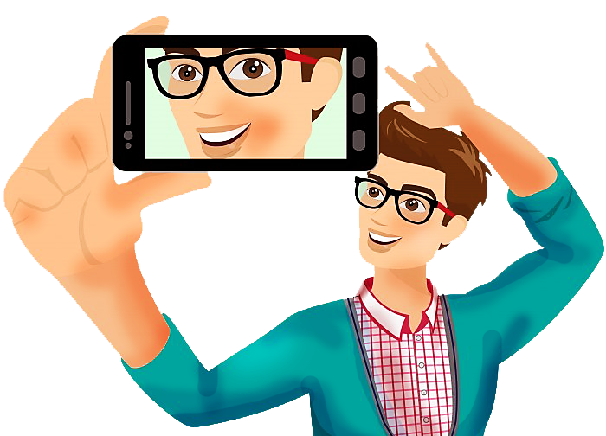
THE AUTHENTIC SELFIE
Finding your voice for God’s kingdom and being heard in the midst of the world’s noise.

Slide 2
Being a presentation by Chude Jideonwo, Managing Partner of Red Media Africa at The Church 3:16 “Authentic Selfie” Event -12 July 2015, Lagos, Nigeria

Slide 3
My favourite 3:16
Daniel 3: 16
16 Shadrach, Meshach, and Abednego, answered and said to the king, O Nebuchadnezzar, we are not careful to answer thee in this matter.
17"If it be so, our God whom we serve is able to deliver us from the furnace of blazing fire; and He will deliver us out of your hand, O king. 18"But even if He does not, let it be known to you, O king, that we are not going to serve your gods or worship the golden image that you have set up."

Slide 4
Do you LOVE God?
Matthew 22: 37 – 40
37 Jesus replied: “‘Love the Lord your God with all your heart and with all your soul and with all your mind.’[a] 38 This is the first and greatest commandment. 39 And the second is like it: ‘Love your neighbour as yourself.’[b] 40 All the Law and the Prophets hang on these two commandments.”
Like David, Abraham, Moses?
"The Lord would speak to Moses face to face, as a man speaks with his friend” (Exodus 33:11).

Slide 5
Why do you come to church?
To be blessed, to be rich, to pass exams? | Unbelievers get that! | Or to be part of his sheer amazingness?
Matthew 17 1 – 4 After six days Jesus took with him Peter, James and John the brother of James, and led them up a high mountain by themselves. 2 There he was transfigured before them. His face shone like the sun, and his clothes became as white as the light. 3 Just then there appeared before them Moses and Elijah, talking with Jesus.

Slide 6
Why do you come to church?
4 Peter said to Jesus, “Lord, it is good for us to be here. If you wish, I will put up three shelters—one for you, one for Moses and one for Elijah.”
Driving through Sheraton and hearing God and being in such a place of purity

Slide 7
Let me remind you about this guy
a) He just wants to fellowship
Psalm 27:8 NLT My heart has heard you say, “Come and talk with me.” And my heart responds, “LORD, I am coming.”
Jeremiah 29:13 admonishes us, “And ye shall seek me, and find me, when ye shall search for me with all your heart.” Proverbs 8:17 states, “I love them that love me, and those that seek me early shall find me.”
Psalm 14:2 The LORD looks down from heaven on all mankind to see if there are any who understand, any who seek God.

Slide 8
b) He just wants to take care of you
"Give God all your worries and all your cares for he is always thinking about you watching everything that concerns you" (1 Peter 5:7).
Psalm 121: 1 – will Lift Up My Eyes to the Hills
1A Song of Ascents. I will lift up my eyes to the mountains; From where shall my help come? 2My help comes from the LORD, Who made heaven and earth.…

Slide 9
Psalm 27:1-5
1(A Psalm of David.) The LORD is my light and my salvation; whom shall I fear? the LORD is the strength of my life; of whom shall I be afraid?
2 When the wicked, even mine enemies and my foes, came upon me to eat up my flesh, they stumbled and fell.
3 Though an host should encamp against me, my heart shall not fear: though war should rise against me, in this will I be confident.
4 One thing have I desired of the LORD, that will I seek after; that I may dwell in the house of the LORD all the days of my life, to behold the beauty of the LORD, and to enquire in his temple.
5 For in the time of trouble he shall hide me in his pavilion: in the secret of his tabernacle shall he hide me; he shall set me up upon a rock.

Slide 10
c) He wants to forgive you every sin
“Therefore this is what the Lord says, ‘If you repent, I will restore you that you may serve me.’” (Jeremiah 15:19a)
“I, even I, am he who blots out your transgressions, for my own sake, and remembers your sins no more.” (Isaiah 43:25)
2 Chron 7:14
my people, which are called by my name, shall humble themselves, and pray, and seek my face, and turn from their wicked ways; then will I hear from heaven, and will forgive their sin, and will heal their land.

Slide 11
He is mind-ful of you. Mindful!
Psalm 8: 4 When I consider Your heavens, the work of Your fingers, The moon and the stars, which You have ordained; 4What is man that You take thought of him, And the son of man that You care for him? 5Yet You have made him a little lower than God, And You crown him with glory and majesty!
Deuteronomy 4:29: But if from there you seek the Lord your God, you will find him if you seek him with all your heart and with all your soul.
God promises you: “You will seek Me and find Me, when you seek me with all your heart” (Jer 29:13).

Slide 12
The bible is for us, not for him
Romans 13:9–10, “The commandments, ‘Do not commit adultery,’ ‘Do not murder,’ ‘Do not steal,’ ‘Do not covet,’ and whatever other commandment there may be, are summed up in this one rule: ‘Love your neighbour as yourself.’ Love does no harm to its neighbour. Therefore love is the fulfilment of the law.”

Slide 13
If you knew all of this deep insight, you would be incredibly confident in your identity as a child of God
In your selfie as someone's whose present and future are certain
Daniel 3: 16
16 Shadrach, Meshach, and Abednego, answered and said to the king, O Nebuchadnezzar, we are not careful to answer thee in this matter.
17"If it be so, our God whom we serve is able to deliver us from the furnace of blazing fire; and He will deliver us out of your hand, O king. 18"But even if He does not, let it be known to you, O king, that we are not going to serve your gods or worship the golden image that you have set up."

Slide 14
YOUR CORE | YOUR IDENTITY
Proverbs 4:25
25 Let your eyes look directly forward,
and your gaze be straight before you.
Psalm 27:1
Of David. The LORD is my light and my salvation-- whom shall I fear? The LORD is the stronghold of my life-- of whom shall I be afraid?

Slide 15
Psalm 1:1-6
1Blessed is the man that walketh not in the counsel of the ungodly, nor standeth in the way of sinners, nor sitteth in the seat of the scornful.
2But his delight is in the law of the LORD; and in his law doth he meditate day and night.
3And he shall be like a tree planted by the rivers of water, that bringeth forth his fruit in his season; his leaf also shall not wither; and whatsoever he doeth shall prosper.
4The ungodly are not so: but are like the chaff which the wind driveth away.
5Therefore the ungodly shall not stand in the judgment, nor sinners in the congregation of the righteous.
6For the LORD knoweth the way of the righteous: but the way of the ungodly shall perish.

Slide 16
Proverbs 4: 20 – 23
20 My son, attend to my words; incline thine ear unto my sayings.
21 Let them not depart from thine eyes; keep them in the midst of thine heart.
22 For they are life unto those that find them, and health to all their flesh.
23 Keep thy heart with all diligence; for out of it are the issues of life.

Slide 17
Isaiah 65:1-4 NLT
The Lord says, “I was ready to respond, but no one asked for help. I was ready to be found, but no one was looking for me. I said, ‘Here I am, here I am!’ to a nation that did not call on my name.All day long I opened my arms to a rebellious people. But they follow their own evil paths and their own crooked schemes.All day long they insult me to my face by worshiping idols in their sacred gardens. They burn incense on pagan altars.

Slide 18
Philippians 3:12-14 New International Version (NIV)
12 Not that I have already obtained all this, or have already arrived at my goal, but I press on to take hold of that for which Christ Jesus took hold of me. 13 Brothers and sisters, I do not consider myself yet to have taken hold of it. But one thing I do: Forgetting what is behind and straining toward what is ahead, 14 I press on toward the goal to win the prize for which God has called me heavenward in Christ Jesus.
Numbers 6:24-27
The LORD bless you and keep you: The LORD make his face to shine upon you, and be gracious to you: The LORD lift up his countenance upon you, and give you peace.

Slide 19
THANK YOU

