Slide 1
Welcome to RED
Some call this an induction, we call this inspiration

Slide 2
Can we meet you?
your lives,
your motivations,
your visions,
your families,
and much more.

Slide 3
Who are we?
What is Media?
Why do We focus on Africans and in Africa?
Business or NGO?
4. We are Both and everything !

Slide 4
OUR HISTORY
2004
Founders met
2005
Red STRAT registered as a business name
2006
The flagship, The Future Awards brand was launched in Lagos
2007
Registered properly as LTD
2008
TV show, Rubbin’ Minds was launched
2009
First Office was set up in Surulere, Lagos
2010
Ngozi Okonjo Iwela was keynote speaker, inspired Enough is Enough (full time business) protest and Organization
Y! Magazine was launched
Business run Full time by Founders
2011
Two co-founders incorporated New company: Red Media
Y! magazine interviewed A Sitting President
and was also on the Front cover of the magazine in the History of Nigeria
2012
Registered the Y Brand:
Gen Y! was incorporated
2013
The Future Project was registered as an Independent organistion
The 1st Youth brand - The Future Awards hosts in Aso rock Villa
Later Became The Future Awards Africa
2014
Hits Milestone: the 75 team member – Across the Offices
APC Presidential Campaign Council employed the services of Statecraft to run the Presidential campaign for GMB
Nigerian Media Agency to run the Presidential Campaign under the age of 30
2015
Hits 10 year landmark- the brand RED
Four offices: Nigeria & UK
Network of Companies and Brands

Slide 5
Our twin goals: Inspiration and Profitability

Slide 6
Our Bottom line is not just Money. It’s SOCIAL CAPITAL
Our Currency is INFLUENCE
We Believe in Market forces giving best Outcomes –
Capitalism, Democracy
Business is our platform, the Media is our tool

Slide 7
Brand Archetype
MAGICIAN
Revolutionary

Slide 8
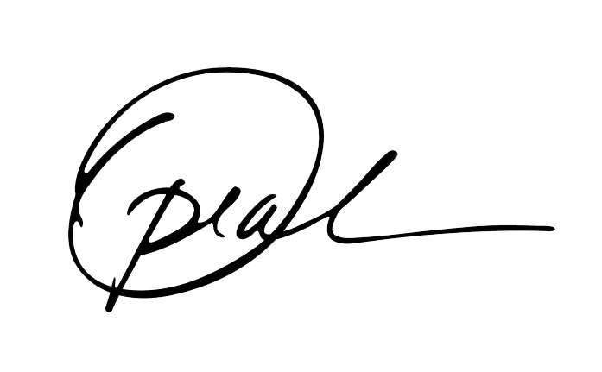
Brands We Love
WHY
IS NOT HERE

Slide 9
OUR Family
(21 THINGS WE LOOK FOR IN A TEAM MEMBER)
1. Can think on feet quick on the take
2. Able to express thoughts clearly
3. Can represent company
4. Can strategize
5. Excited by the media and projects
6. Able to work on team
7. Disciplined
8. Competitive and ambitious
9. Takes joy in their work
10. Takes a global perspective
11. Able to think through and solve problems
12. Can focus on results and outcomes
13. Informed about work and environment
14. Can grow fast
15. Committed to performing because he /she has a higher sense of responsibility
16. Hardworking and doesn’t give up
17. Is not afraid of debate and can put up his/her thoughts confidently and without feeling bad
18. Able to speak boldly and disagree
19. Is trustworthy and knows how to trust
20. An appreciate for higher arts of living – serendipity, beauty, love, spontaneity and poetry in your soul
21. A spirit of service

Slide 10
My people, my people
We are inspired by general electric to build a new model of leaders
We are inspired by Jesus to build a new kind of family – optimal, communal

Slide 11
The RED Evolution Cycle

Slide 12
Potential, attitude and culture fit
Recruitment
Establish credibility
Be loaded with work and pressure
Crucible
Feel overwhelmed
Stagger
Doubt self
Fall
Seek and get support
Toughen up
Rise
Thrive
Master
Beauty

Slide 13
systems and structures
Execution:
Content
Communication &
Marketing Development
Divisions:
Strategy,
People,
Execution.

Slide 14
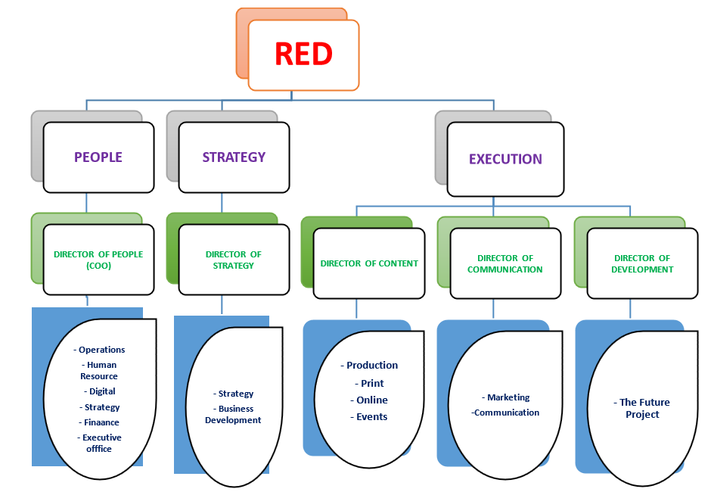
Present team Strength

Slide 15
M.D
Founding Partner
Partner & Member of Executive Board
Senior Vice President
Vice President
Senior Manager II
Senior Manager
Manager
Lead II
Lead
Senior Associate II
Senior Associate I
Associate II
Associate
Management Trainee
Intern

Slide 17
TEAMS
TEAMS
INTERNAL
PEOPLE
CONTENT
DEVELOPMENT
ENTERPRISE
CITIZENSHIP SPECIAL PROJECTS
STRATEGY
( & BUSINESS DEVELOPMENT )
ONLINE
PRINT TV
ADMINISTRATION & OFFICE OPERATIONS
DATA & ANALYSIS RESEARCH &
AMAZING DOCUMENTS
DIGITAL
WEALTH
( INVESTMENT, ASSESTS & WEALTH, PLANNING, FINANCING & CAPITAL, TAX & INSURANCE, COST CONTROL ANDTRANSACTIONS )
RADIO
EXECUTIVE OFFICE CHIEF OF STAFF
( SPECIAL OPERATIONS, PROJECT MGT., CORPORATE SERVICES,
INNOVATION
( FUTURE LAB, CUTTING EDGE )
EVENTS
SET-UP
COMMUNICATION
( & MARKETING )
IDEATION &
PRODUCT DEVELOPMENT
RISK & REVIEW
MARKETING (OPPORTUNITIES,MARKETS, MEDIA SALES )
COMMUNICATION
SHARED SERVICES & TRAFFIC )
TALENT
( COMMUNITY
, REDx,TALENT PERFORMANCE MGT.,
HUMANS OF RED )
THE
'EVERYTHING
YOUTH'
STATECRAFT
company.
#Media #Youth #Africa

Slide 18
#TeamRED - This is the expression of our
corporate identity
#HumansOfRED – This expresses our internal
identity; as a community, and a family.

Slide 19
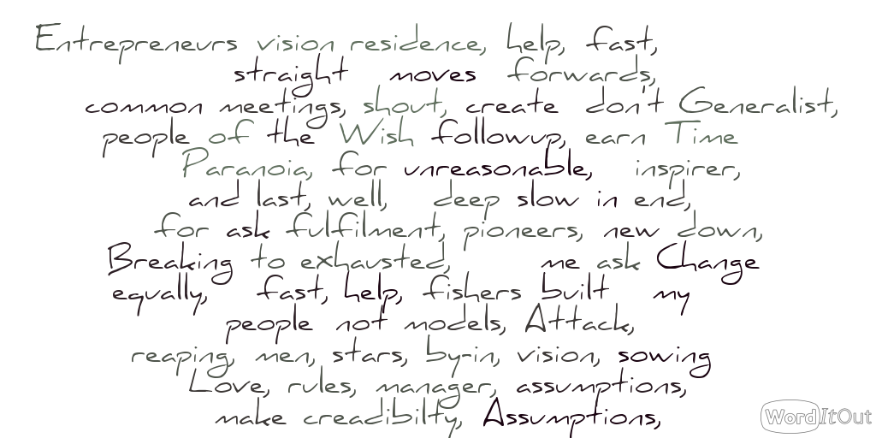
Meet the CEO

Slide 20
WHAT THE FUTURE HOLDS

Slide 21
Long Term Vision/Where Are We Going
TV Stations
Radio Stations
Africa’s biggest network of online media brand
REDx Africa’s biggest Media School
We want to build new Models, empower Generations
Build a company that can reach and inspire at least half of the African population using the media brands, platforms and companies we build.
We WILL Change the World

Slide 22
Status update
Where we are
What you will confront
How we want to do It
Where we want you to take us
The 2015 Strategy
Goals: Group, Brands, SBUs,BUs

Slide 23
How you role leads to the bottom line

Slide 24
Status Feedback
What you want to do and how you want to do it

Slide 25
Questions
Questions
Questions

Slide 26
THANK YOU

