Slide 1
Wake Up And Smell The Coffee
The rise of digital media
PRESENTED AT: SMELL THE COFFEE CONFERENCE

Slide 2
Why Are We Here?
To ‘Wake Up’ means:
To become roused from sleep
To become roused from a tranquil or inactive
To become cognizant or aware of something
To remain awake for some purpose

Slide 3
THERE IS AN URGENT NEED FOR US TO BECOME AWARE OF WHERE THE WORLD IS GOING, IN ORDER TO PROPERLY POSITION OURSELVES TO BENEFIT

Slide 4
What is digital media?
Different from analog media
Easier to control
Can be copied without losing quality

Slide 5
PLATFORMS

Slide 6
Examples
Mobile phones
CDs
E-books
Internet
World Wide Web

Slide 7
A decade of connectivity in Nigeria
1,569,050 lines in 2002 and 1.89 teledensity
148,495,205 in July 2015 and107.67 teledensity

Slide 8
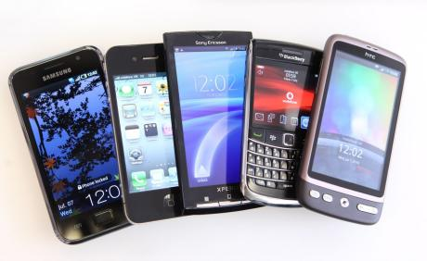
Ever cheaper and more powerful phones

Slide 9
The Telco Data Wars

Slide 10
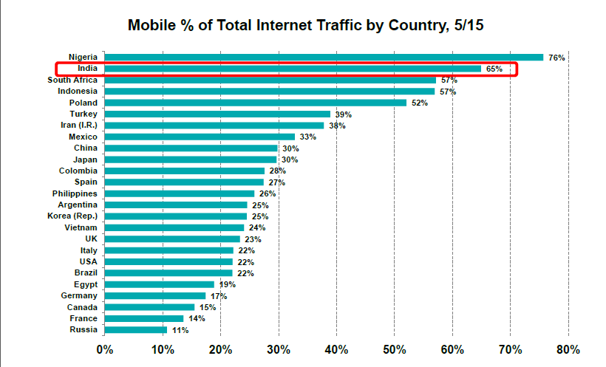
The most mobile country in the world

Slide 11
Sharp increase in video consumption in a variety of formats
6 seconds (Vine)
15 seconds (Instagram)
30 seconds (Twitter)
Longer videos

Slide 12
And more channels for Sharing
This generation (and their parents) are now on WhatsApp (900 million users and counting)
BBM
Good old SMS

Slide 13
CONTENT

Slide 14
A few implications
A mobile, social world
Always connected for work and play
Rise of e-commerce (Jumia, Konga)
The on-demand economy (Uber, food on demand, etc)
Audiences with a voracious (endless!) appetite for content

Slide 15
Where RED Stands
A media company that is designed to build anything at all and engage anything that exists using platforms it can find.

Slide 16
Ten jobs that did not exist ten years ago
Chief Listening Officer
Online Community Manager
SEO Specialist
Blogger
App designer
Chief Storyteller
Cloud Services Specialist
Big Data Analyst
Digital Marketing Specialist
User Interface/User Experience designer

Slide 17
The Future
Drone pilots (to monitor pipelines and cover news stories for instance)
How likely is it for your job to be done by a robot?

Slide 18
One last thing

Slide 19
The illiterate of the 21st century will not be those who cannot read and write. It will be those who cannot learn, unlearn and relearn.
Alvin Toffler, Futurist

