Slide 1
HONOUREE RECEPTION

Slide 2
ABIKE DABIRI EREWA

Slide 3
ADE AKINDE

Slide 4
ADESUWA OYENOKWE

Slide 5
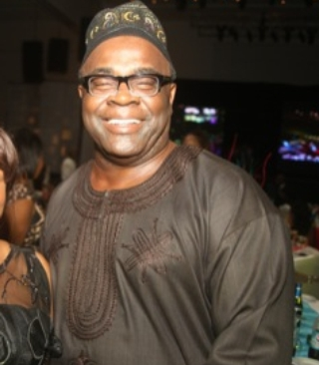
ADEWUNMI
OGUNSANYA

Slide 6
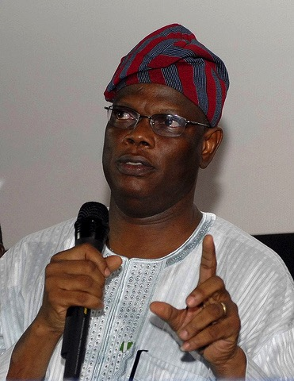
AFOLABI ADESANYA

Slide 7
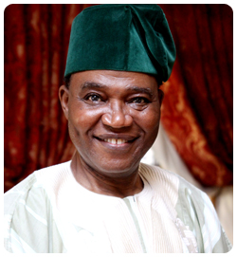
AJIBOLA OGUNSOLA

Slide 8
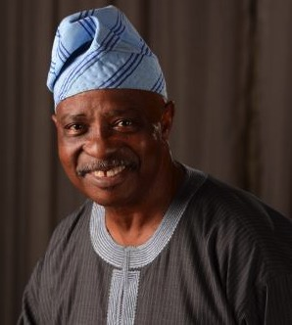
AKIN ODUNSI

Slide 9
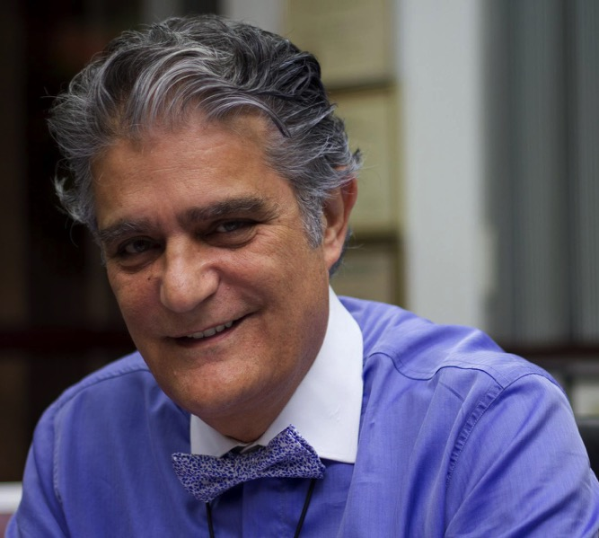
AMIN MOUSSALLI

Slide 10
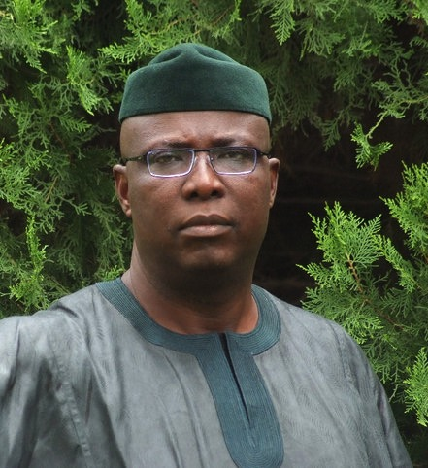
BABAFEMI OJUDU

Slide 11
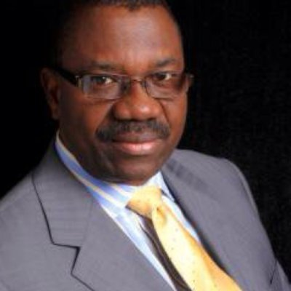
BABU AKINBOBOLA

Slide 12
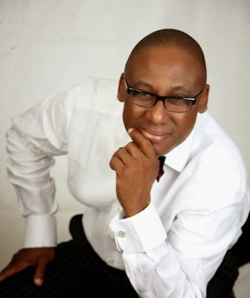
YOMI
BADEJO - OKUSANYA

Slide 13
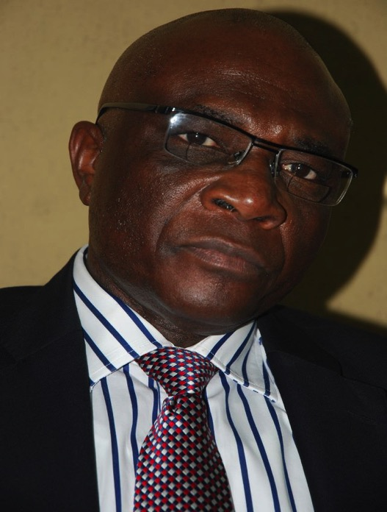
BAYO ONANUGA

Slide 14
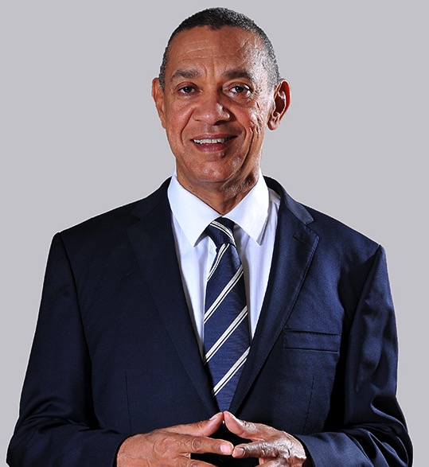
BEN MURRAY - BRUCE

Slide 15
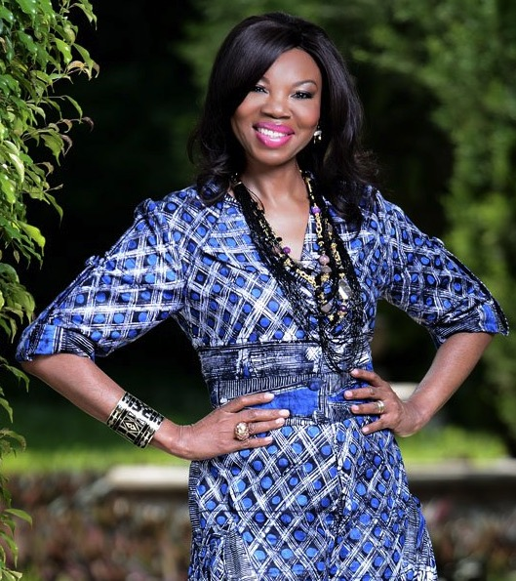
BETTY IRABOR

Slide 16
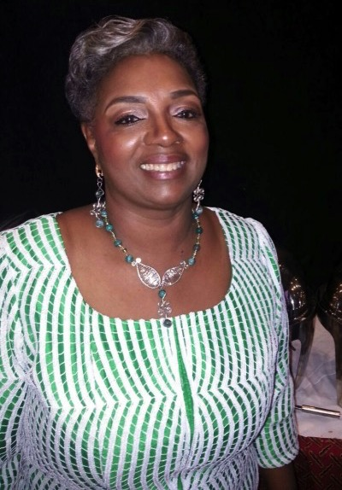
BIMBO OLOYEDE

Slide 17
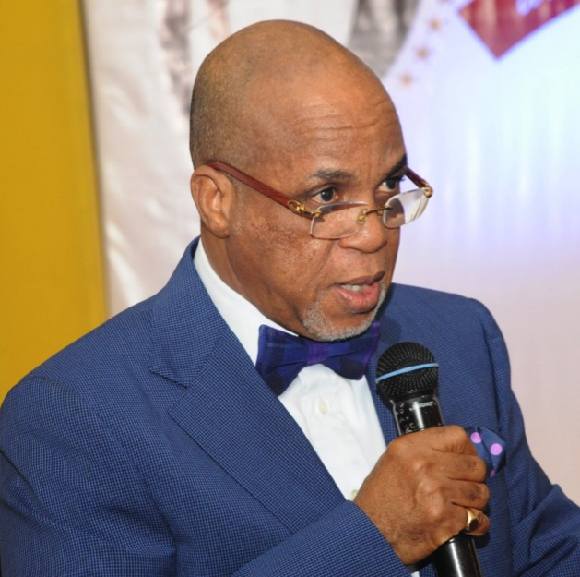
BIODUN SHOBANJO

Slide 18
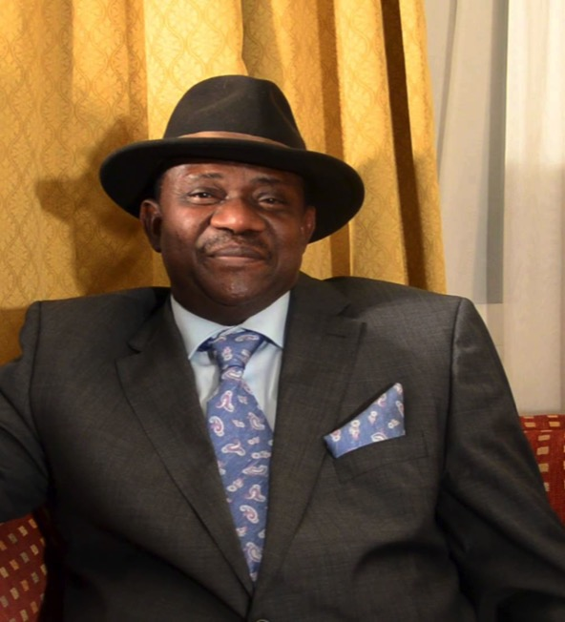
BISI OLATILO

Slide 19
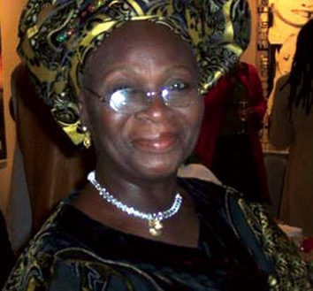
BUKKY AJAYI

Slide 20
BUNMI OKE

Slide 21
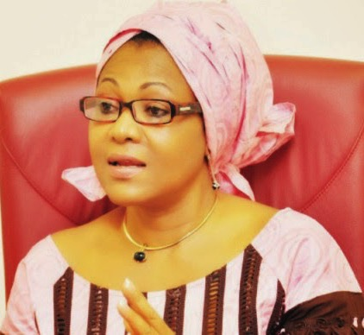
CHRIS ANYANWU

Slide 22
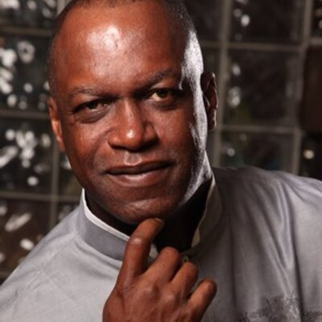
CHRIS UBOSI

Slide 23
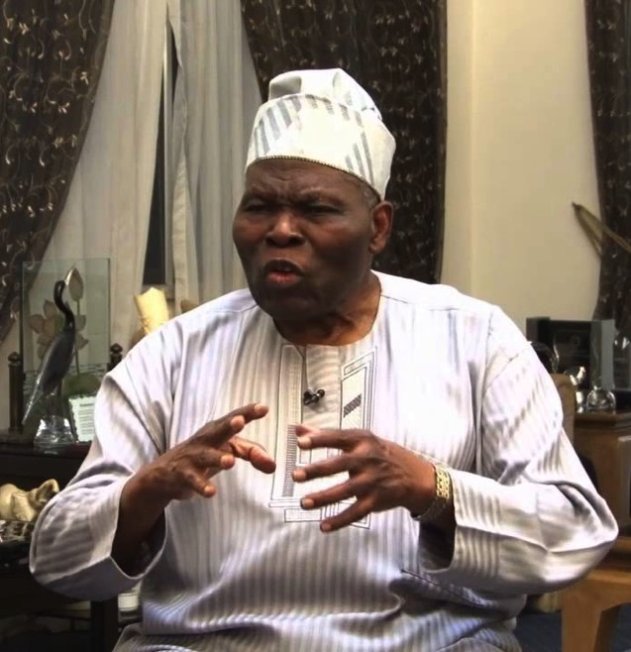
CHRISTOPHER KOLADE

Slide 24
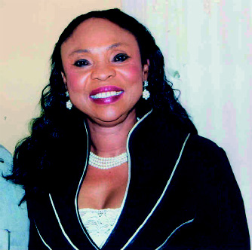
COMFORT OBI

Slide 25
COMFORT OKORONKWO

Slide 26
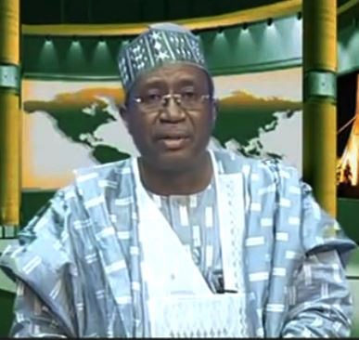
CYRIL STOBER

Slide 27
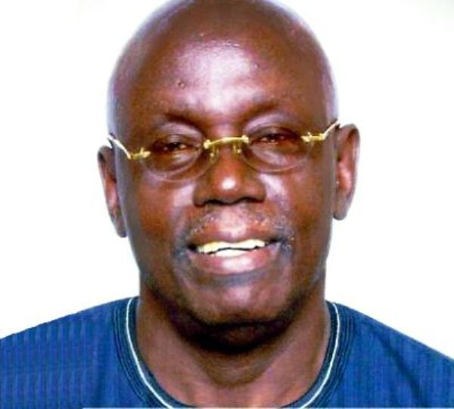
DAN AGBESE

Slide 28
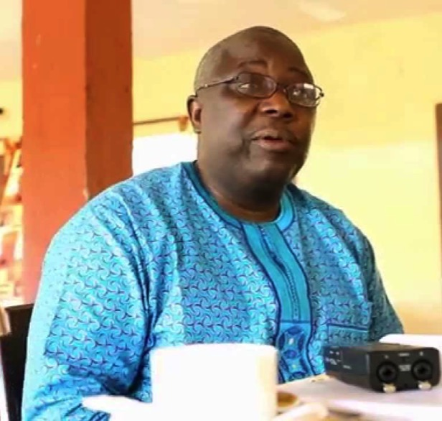
DAPO OLORUNYOMI

Slide 29
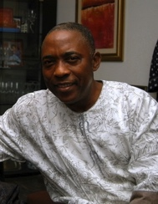
DARE BABARINSA

Slide 30
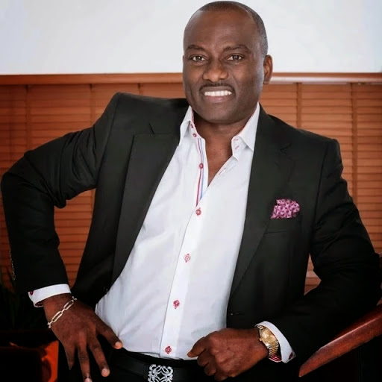
DAYO ADENEYE

Slide 31
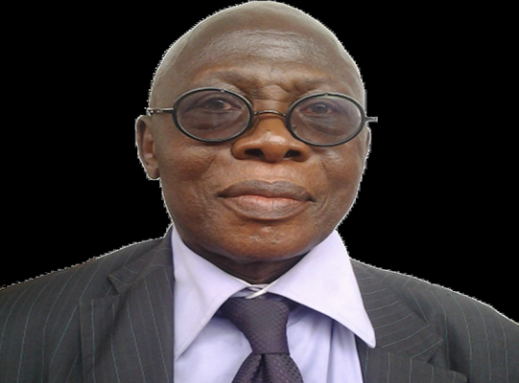
DAYO DUYILE

Slide 32
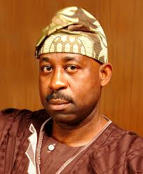
DELE ALAKE

Slide 33
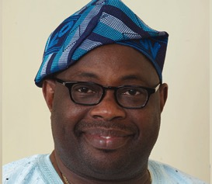
DELE MOMODU

Slide 34
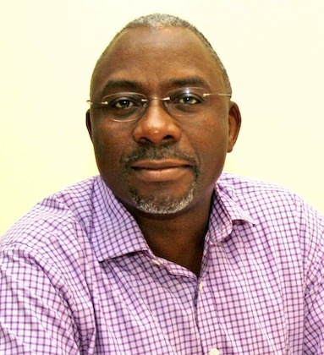
DELE OLOJEDE

Slide 35
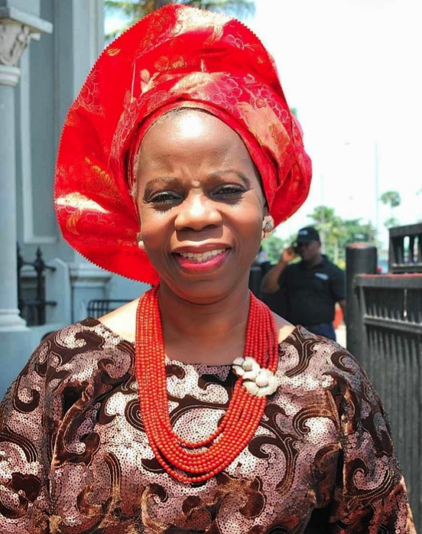
DOYIN ABIOLA

Slide 36
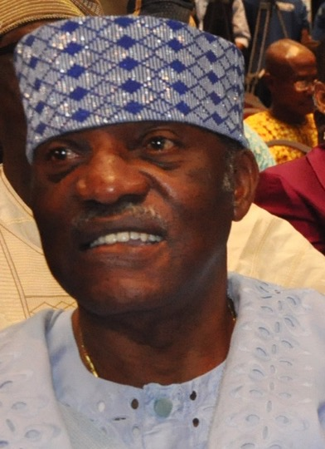
DURO ONABULE

Slide 37
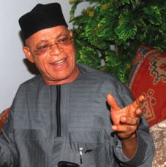
EDDIE IROH

Slide 38
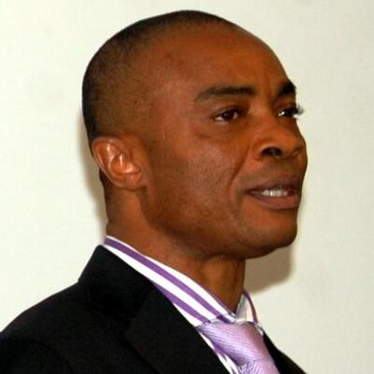
EMEKA OBASI

Slide 39
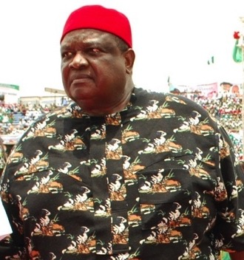
EMMANUEL IWUANYANWU

Slide 40
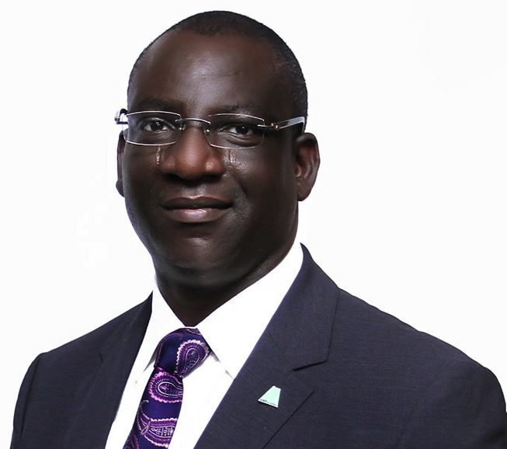
FEMI
AKINTUNDE-JOHNSON

Slide 41
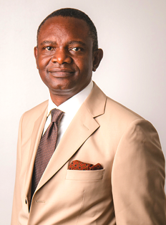
FRANK AIGBOGUN

Slide 42
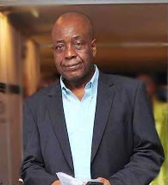
FRANK OLIZE

Slide 43
FUNMI IYANDA

Slide 44
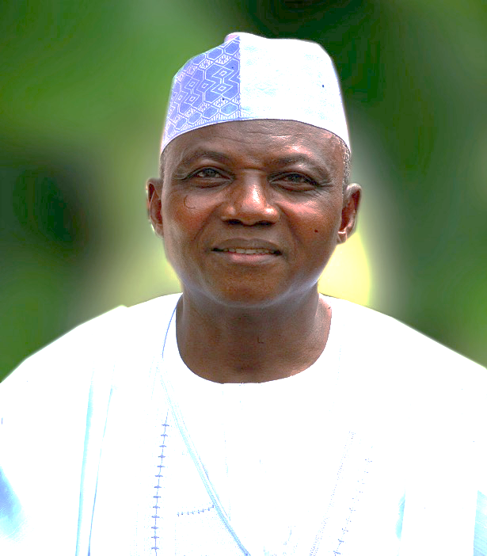
GARBA SHEHU

Slide 45
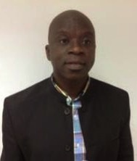
GBENGA OGUNLEYE

Slide 46
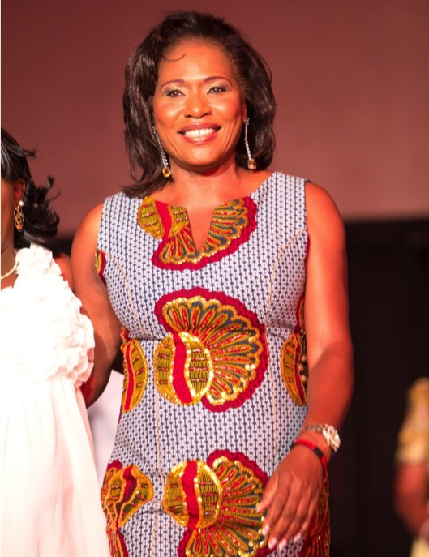
GRACE EGBAGBE

Slide 47
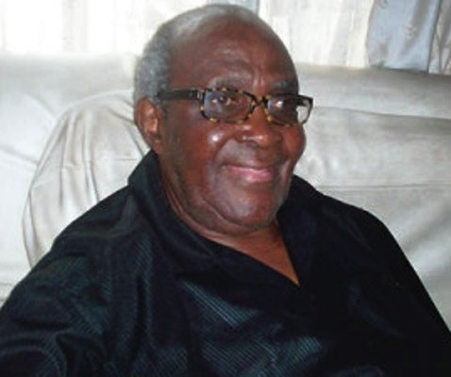
HENRY ODUKOMAIYA

Slide 48
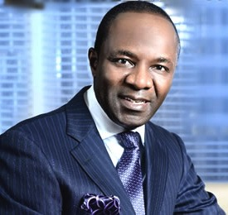
IBE KACHIKWU

Slide 49
IQUO UKOH

Slide 50
JACOB
AKINYEMI JOHNSON

Slide 51
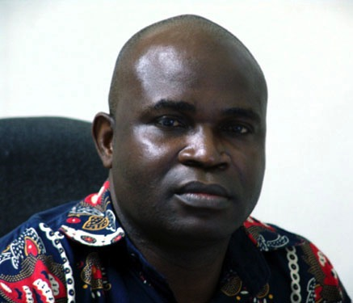
JAHMAN ANIKULAPO

Slide 52
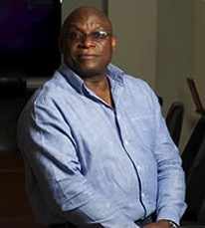
JIMI AWOSIKA

Slide 53
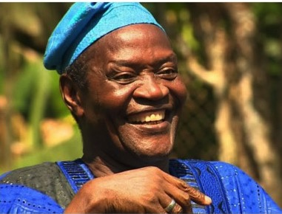
JIMI SOLANKE

Slide 54
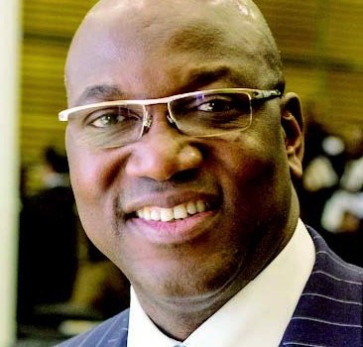
JOHN MOMOH

Slide 55
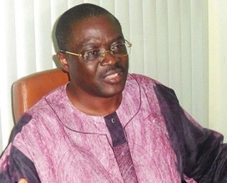
KAYODE SOYINKA

Slide 56
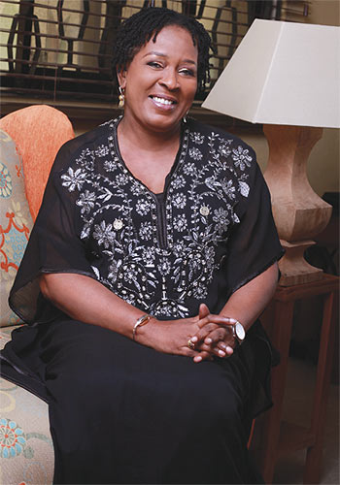
KEHINDE
YOUNG HARRY

Slide 57
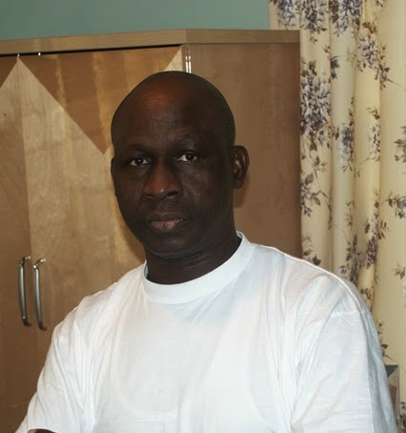
KENNY ADAMSON

Slide 58
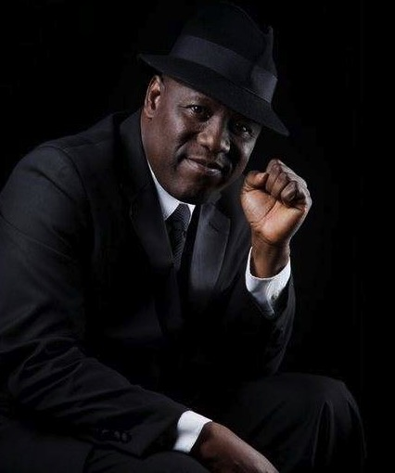
KENNY OGUNGBE

Slide 59
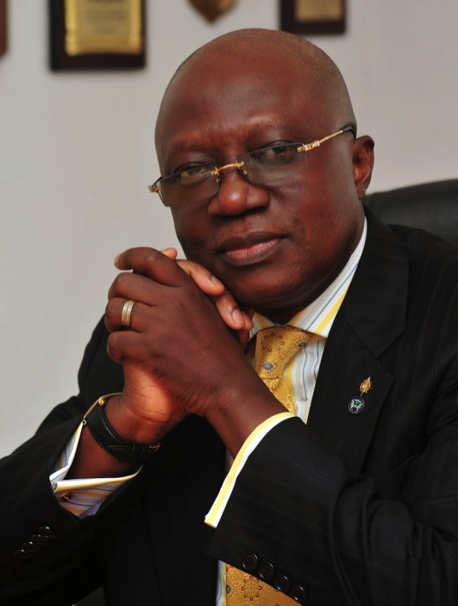
KOLE ADEMULEGUN

Slide 60
KUNLE AJIBADE

Slide 61
KUNLE BAKARE

Slide 62
LABAN NAMME

Slide 63
LANRE IDOWU

Slide 64
LARRY AGOSE

Slide 65
LARRY IZAMOJE

Slide 66
LATEEF JAKANDE

Slide 67
LEKAN OGUNBANWO

Slide 68
LOLU AKINWUNMI

Slide 69
MAIDEN IBRU

Slide 70
MAYOR AKINPELU

Slide 71
MIKE AJEGBO

Slide 72
MIKE AWOYINFA

Slide 73
MO ABUDU

Slide 74
MOHAMMED HARUNA

Slide 75
MODELE
SARAFA YUSUF

Slide 76
MUMUNI ALAO

Slide 77
LAOLU OGUNNIYI

Slide 78
NDUKA OBAIGBENA

Slide 79
NKECHI ALLI BALOGUN

Slide 80
NOSA IGIEBOR

Slide 81
ODIA OFEIMUN

Slide 82
OHI ALEGBE

Slide 83
OLADAPO
CHARLES ABRAHAM

Slide 84
OLATUNJI DARE

Slide 85
OMOWUNMI OWODUNNI

Slide 86
ONYEKA ONWENU

Slide 87
ONYEMA UGOCHUKWU

Slide 88
PATRICK DELE COLE

Slide 89
PETER IGHO

Slide 90
PHIL OSAGIE

Slide 91
PRINCE TONY MOMOH

Slide 92
RAY EKPU

Slide 93
RAYMOND DOKPESI

Slide 94
REUBEN ABATI

Slide 95
RICHARD
MOFE DAMIJO

Slide 96
SADIQ DABA

Slide 97
SAM AMUKA PEMU

Slide 98
SAM NDA-ISAIAH

Slide 99
SEGUN ODEGBAMI

Slide 100
SEGUN OSOBA

Slide 101
SEYE KEHINDE

Slide 102
SIENE
ALLWELL - BROWN

Slide 103
STEVE OMOJAFOR

Slide 104
SONI IRABOR

Slide 105
STEVE OJO

Slide 106
SUNNY SMART COLE

Slide 107
SUNNY
OBAZU-OJEAGBASE

Slide 108
SUNNY OSA-ADUN

Slide 109
TAIWO ALIMI

Slide 110
TAIWO OBE

Slide 111
TAJUDEEN ADEPETU

Slide 112
TOLU OGUNKOYA

Slide 113
TOM ADABA

Slide 114
TONY IREDIA

Slide 115
TUNJI OLUGBODI

Slide 116
UDEME UFOT

Slide 117
VICTORIA EZEOKOLI

Slide 118
VINCENT MADUKA

Slide 119
WALE ADENUGA

Slide 120
YAKUBU MOHAMMED

Slide 121
YEMI OGUNBIYI

Slide 122
#WeWereMadeToDoBigThings!
Follow our brands:
www.aiki.ng | www.ynaija.com | www.ynaija2015.com | tv.ynaija.com | radio.ynaija.com | www.yafri.ca | awards.thefutureafrica.com | www.statecraftinc.com

