Slide 1
How about the un-connected?
by
Chude Jideonwo
at the
New York Media Festival
October 9, 2015

Slide 2
Everyone wants to tell African stories to the world.
But what happens when you want to tell African stories to Africans?

Slide 3
Yay to Facebook, yay to a more connected world, and the new iPad pro.
But Nairobi is not Nashville.

Slide 4
There is no single African story.

Slide 5
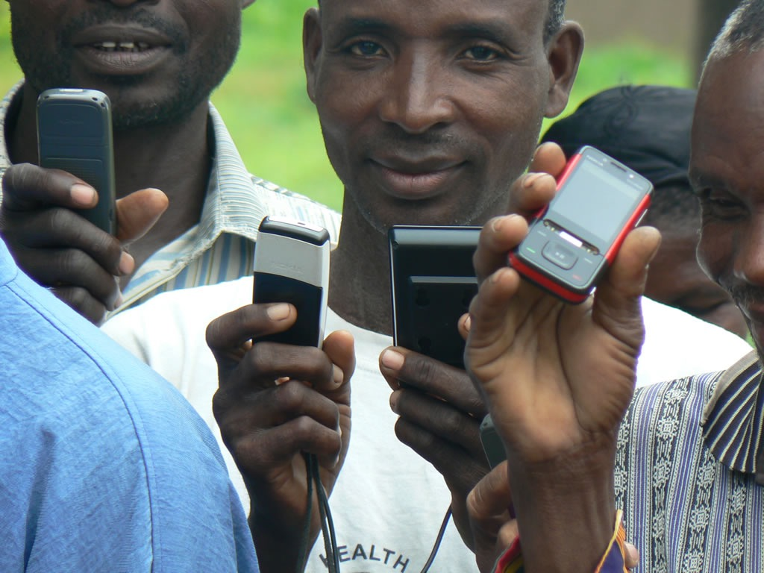
The mobile revolution in Africa
(#AfricaRising, yada, yada)

Slide 6
Nigeria’s incredible growth in connectivity

Slide 7
BUT!

Slide 8
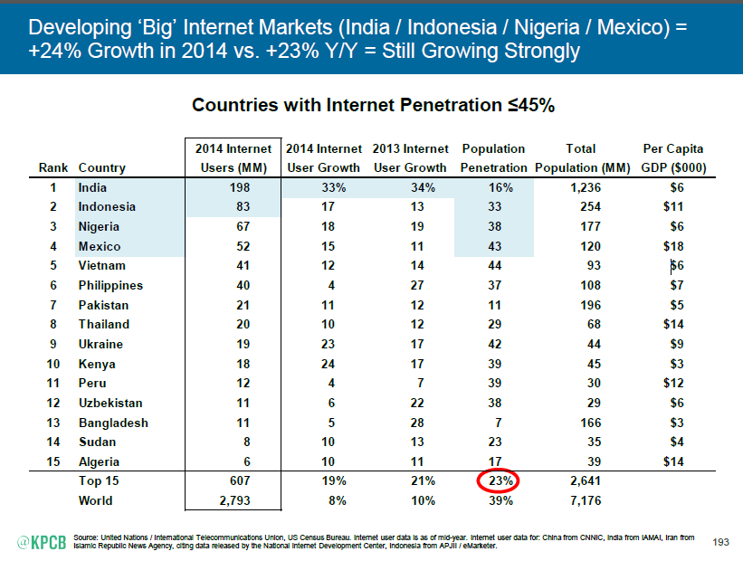
There is still some way to go

Slide 9
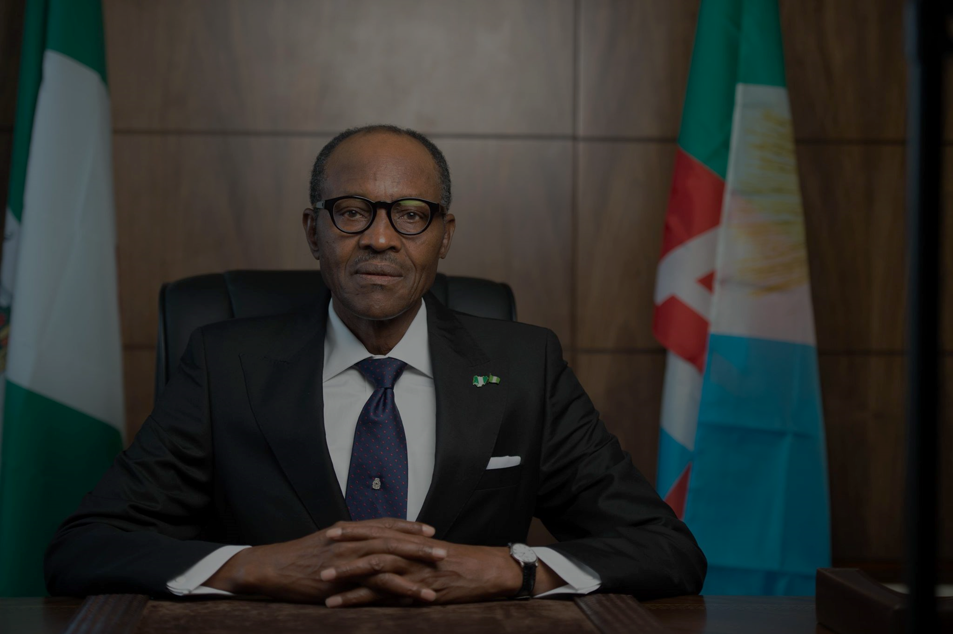
What’s a messenger in this market to do?

Slide 11
Building a movement
Facebook, Twitter, blogs
WhatsApp, Blackberry, 2Go
Offline audiences

Slide 12
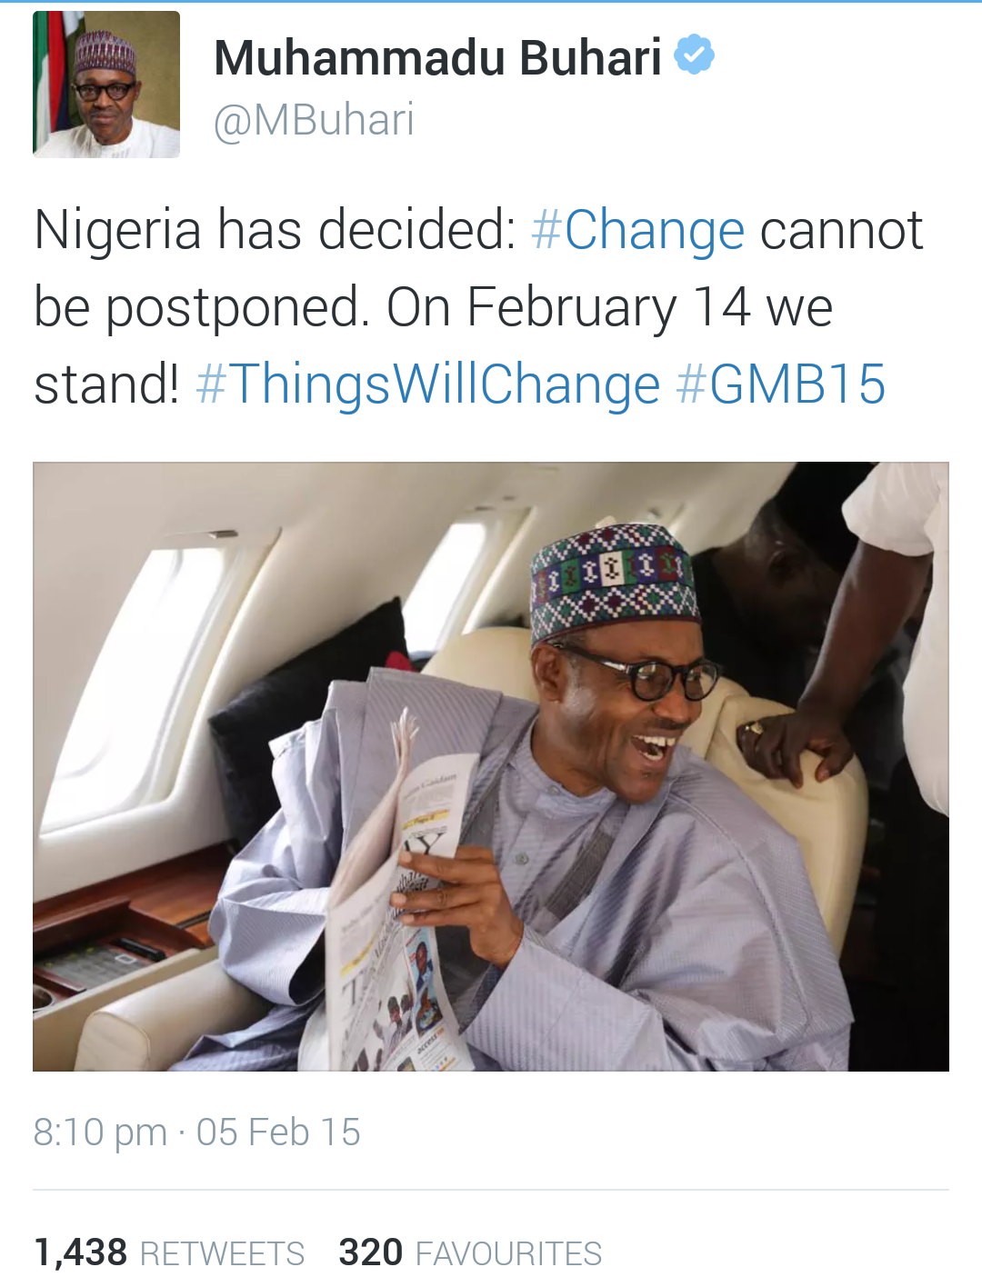
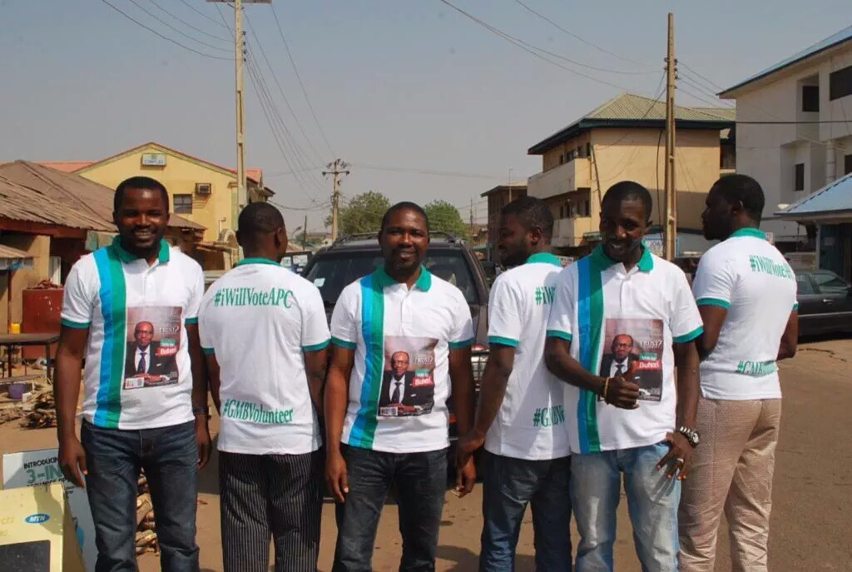
Building a movement

Slide 13
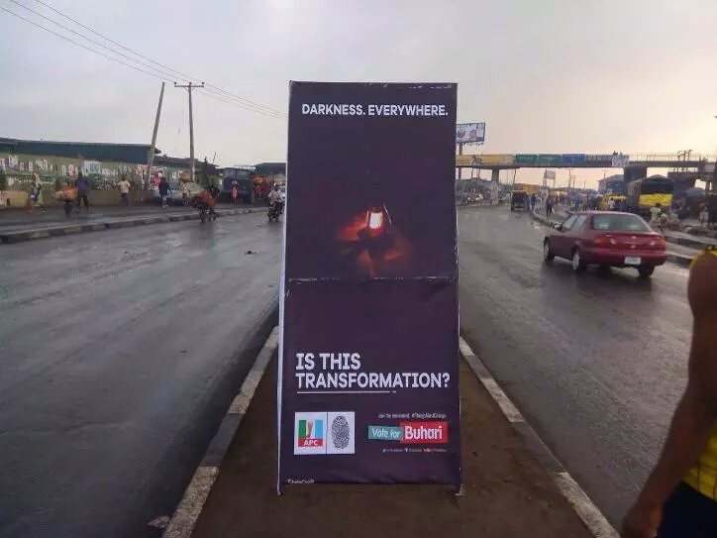
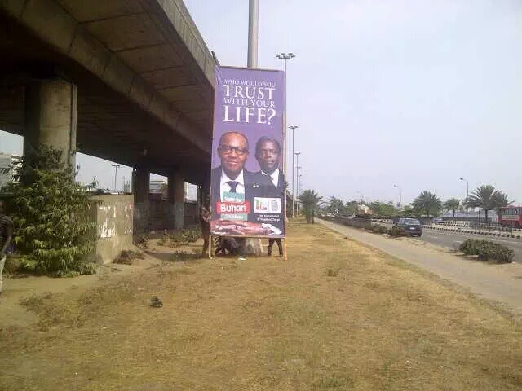
Building a movement

Slide 14
THE CRUX?
Reaching a diverse
audience of the
connected, un-connected and dis-connected (power issues, slow internet, more).

Slide 15
Tools? Meh.
We are here for the
Audience

Slide 16
THANK YOU
From the media company to reach and inspire the largest number of African youth at any time
redmediaafrica.com | @redmediaafrica

